Slide 1

Tales from the jungle
Professor Alice Richardson Statistical Support Network (SSN)
BIBC, November 2025
Notes:
Half hour slot

Slide 2
Overview
What went well
What could have gone better
In the statistical jungle
Conclusion

Slide 3
What went well

Slide 4
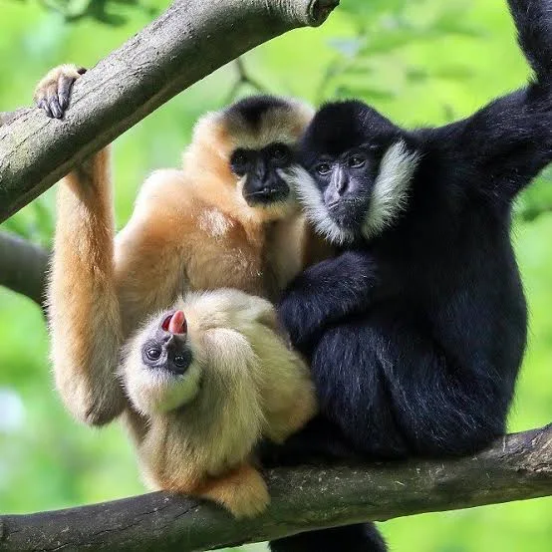
Primatology
Investigating the impacts of logging and hunting pressure on the endangered northern yellow-cheeked crested gibbon Nomascus annamensis in Veun Sai-Siem Pang National Park in Cambodia.
Six main activities: feeding, travelling, resting, scanning, socializing and self-grooming
Beta-binomial outcome, GLMM with chainsaw activity as the key fixed effect
https://nsojournals.onlinelibrary.wiley.com/doi/full/10.1002/wlb3.01196
Notes:
Sarah McGrath

Slide 5
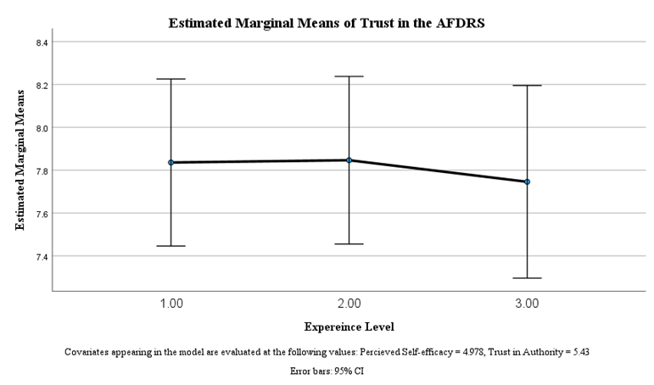
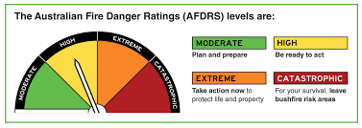
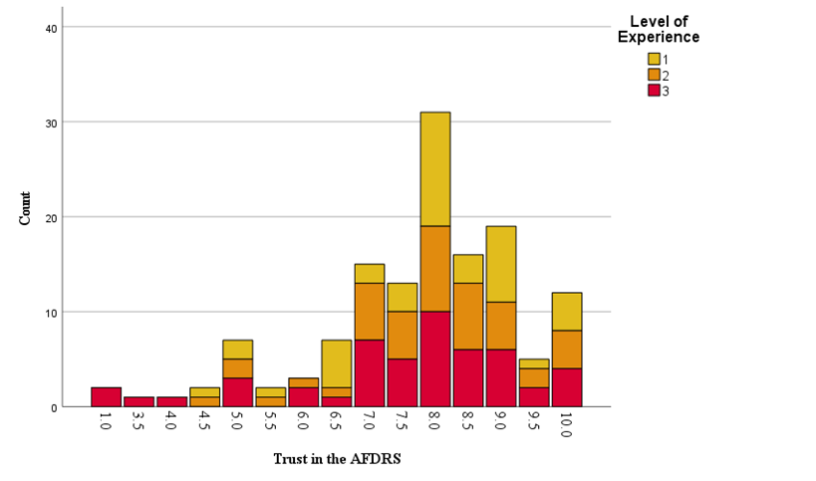
Environment and society
Effect of Level of Experience on Trust (AFDRS) when Self-efficacy and Trust (Agency) are Controlled For (n = 136)
What level of trust does the Western Edge community of the ACT have in the AFDRS?
What psychosocial factors (e.g. Trust (agency), Self-efficacy, Experience) influence levels of trust in the AFDRS?
Trust in the AFDRS by Level of Experience (n = 136)
Notes:
Kate Jones

Slide 6
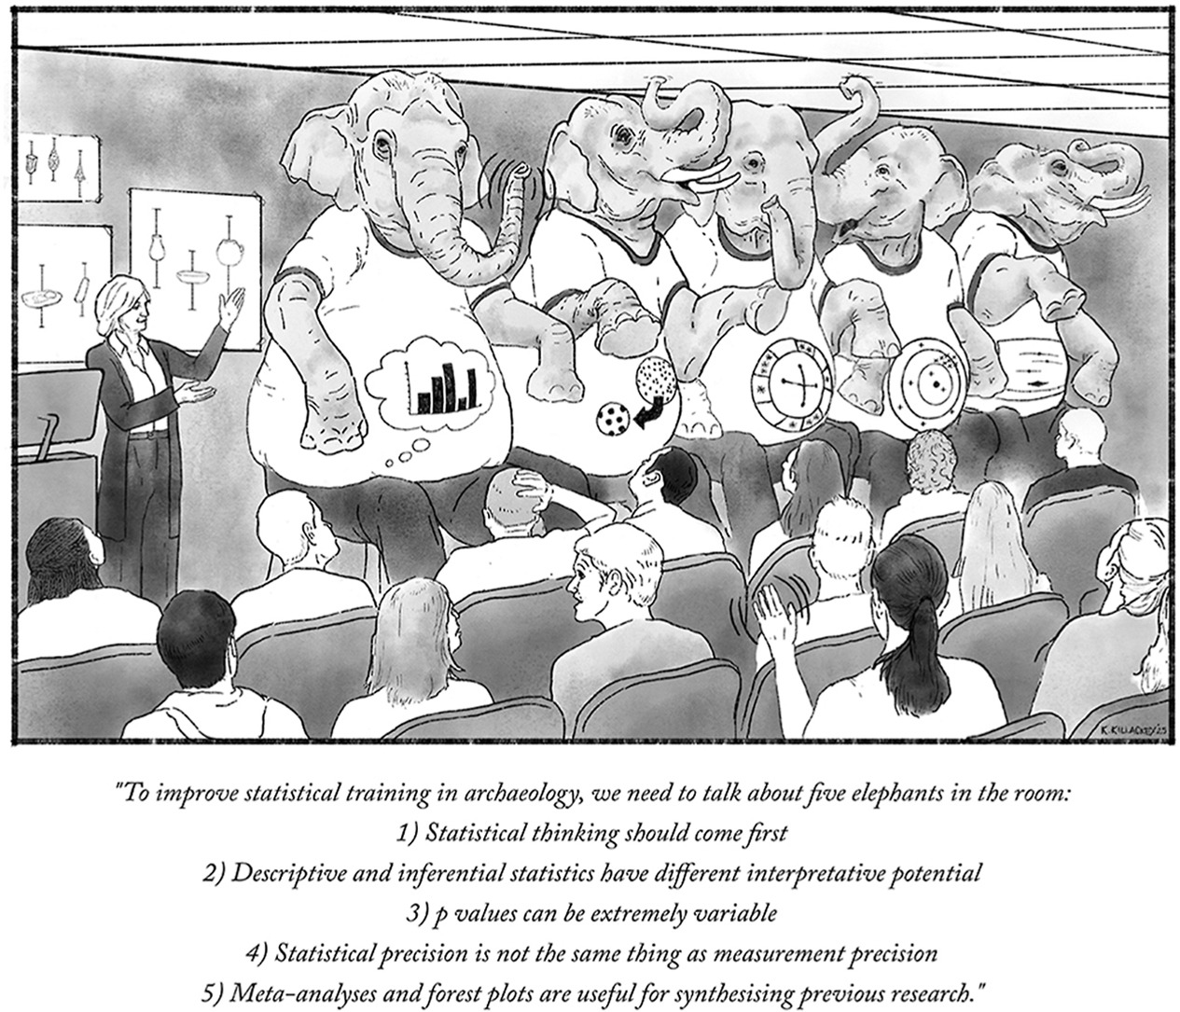
Archaeology
Improving statistical training in archaeological science
Statistical thinking should come first
Descriptive and inferential statistical have different interpretative potential
P values can be extremely variable
Statistical precision is not the same as measurement precision
Meta-analyses and forest plots are useful for synthesising previous research
https://doi.org/10.1016/j.jas.2025.106220
Notes:
Petra Vaiglova

Slide 7
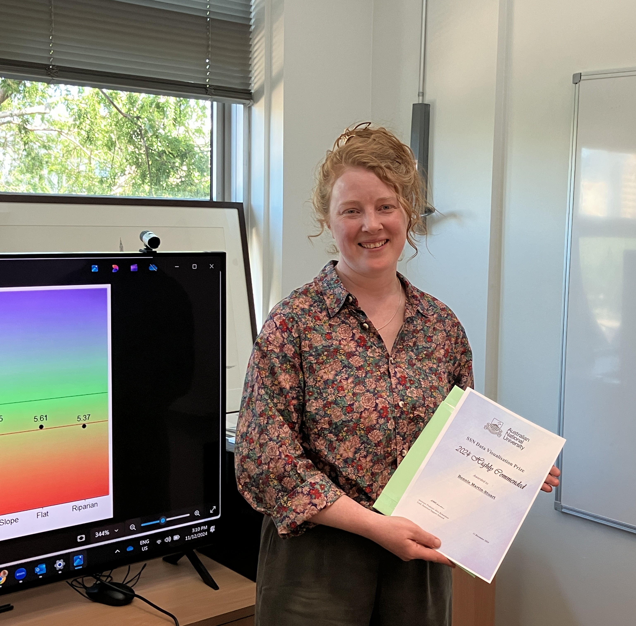

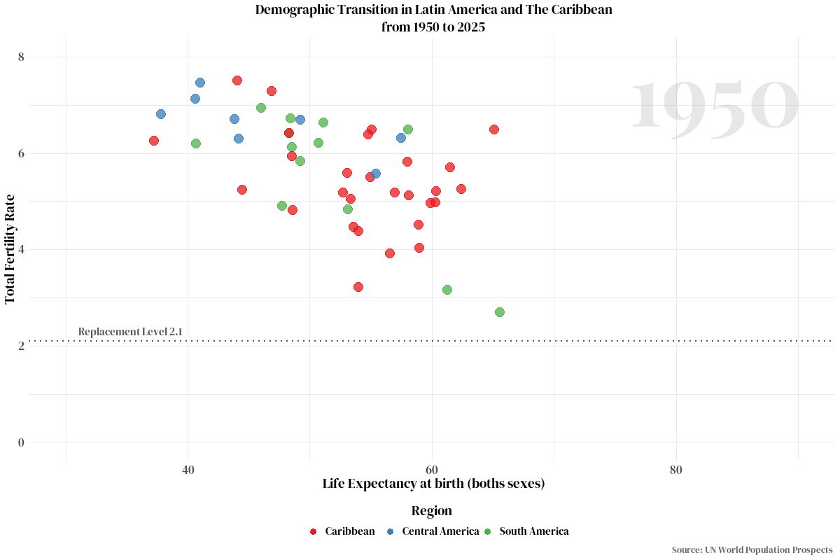
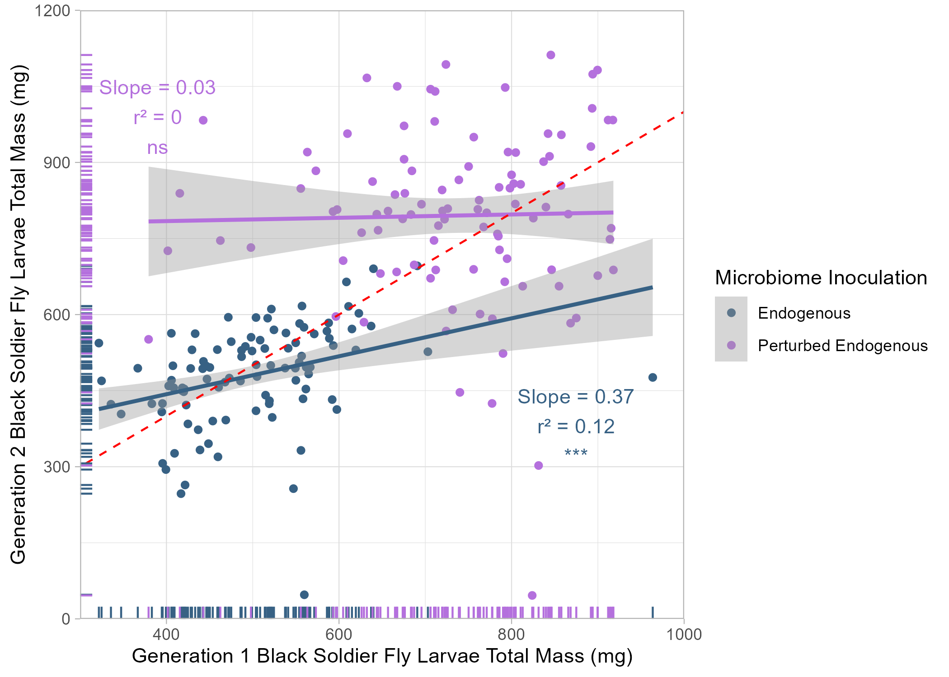
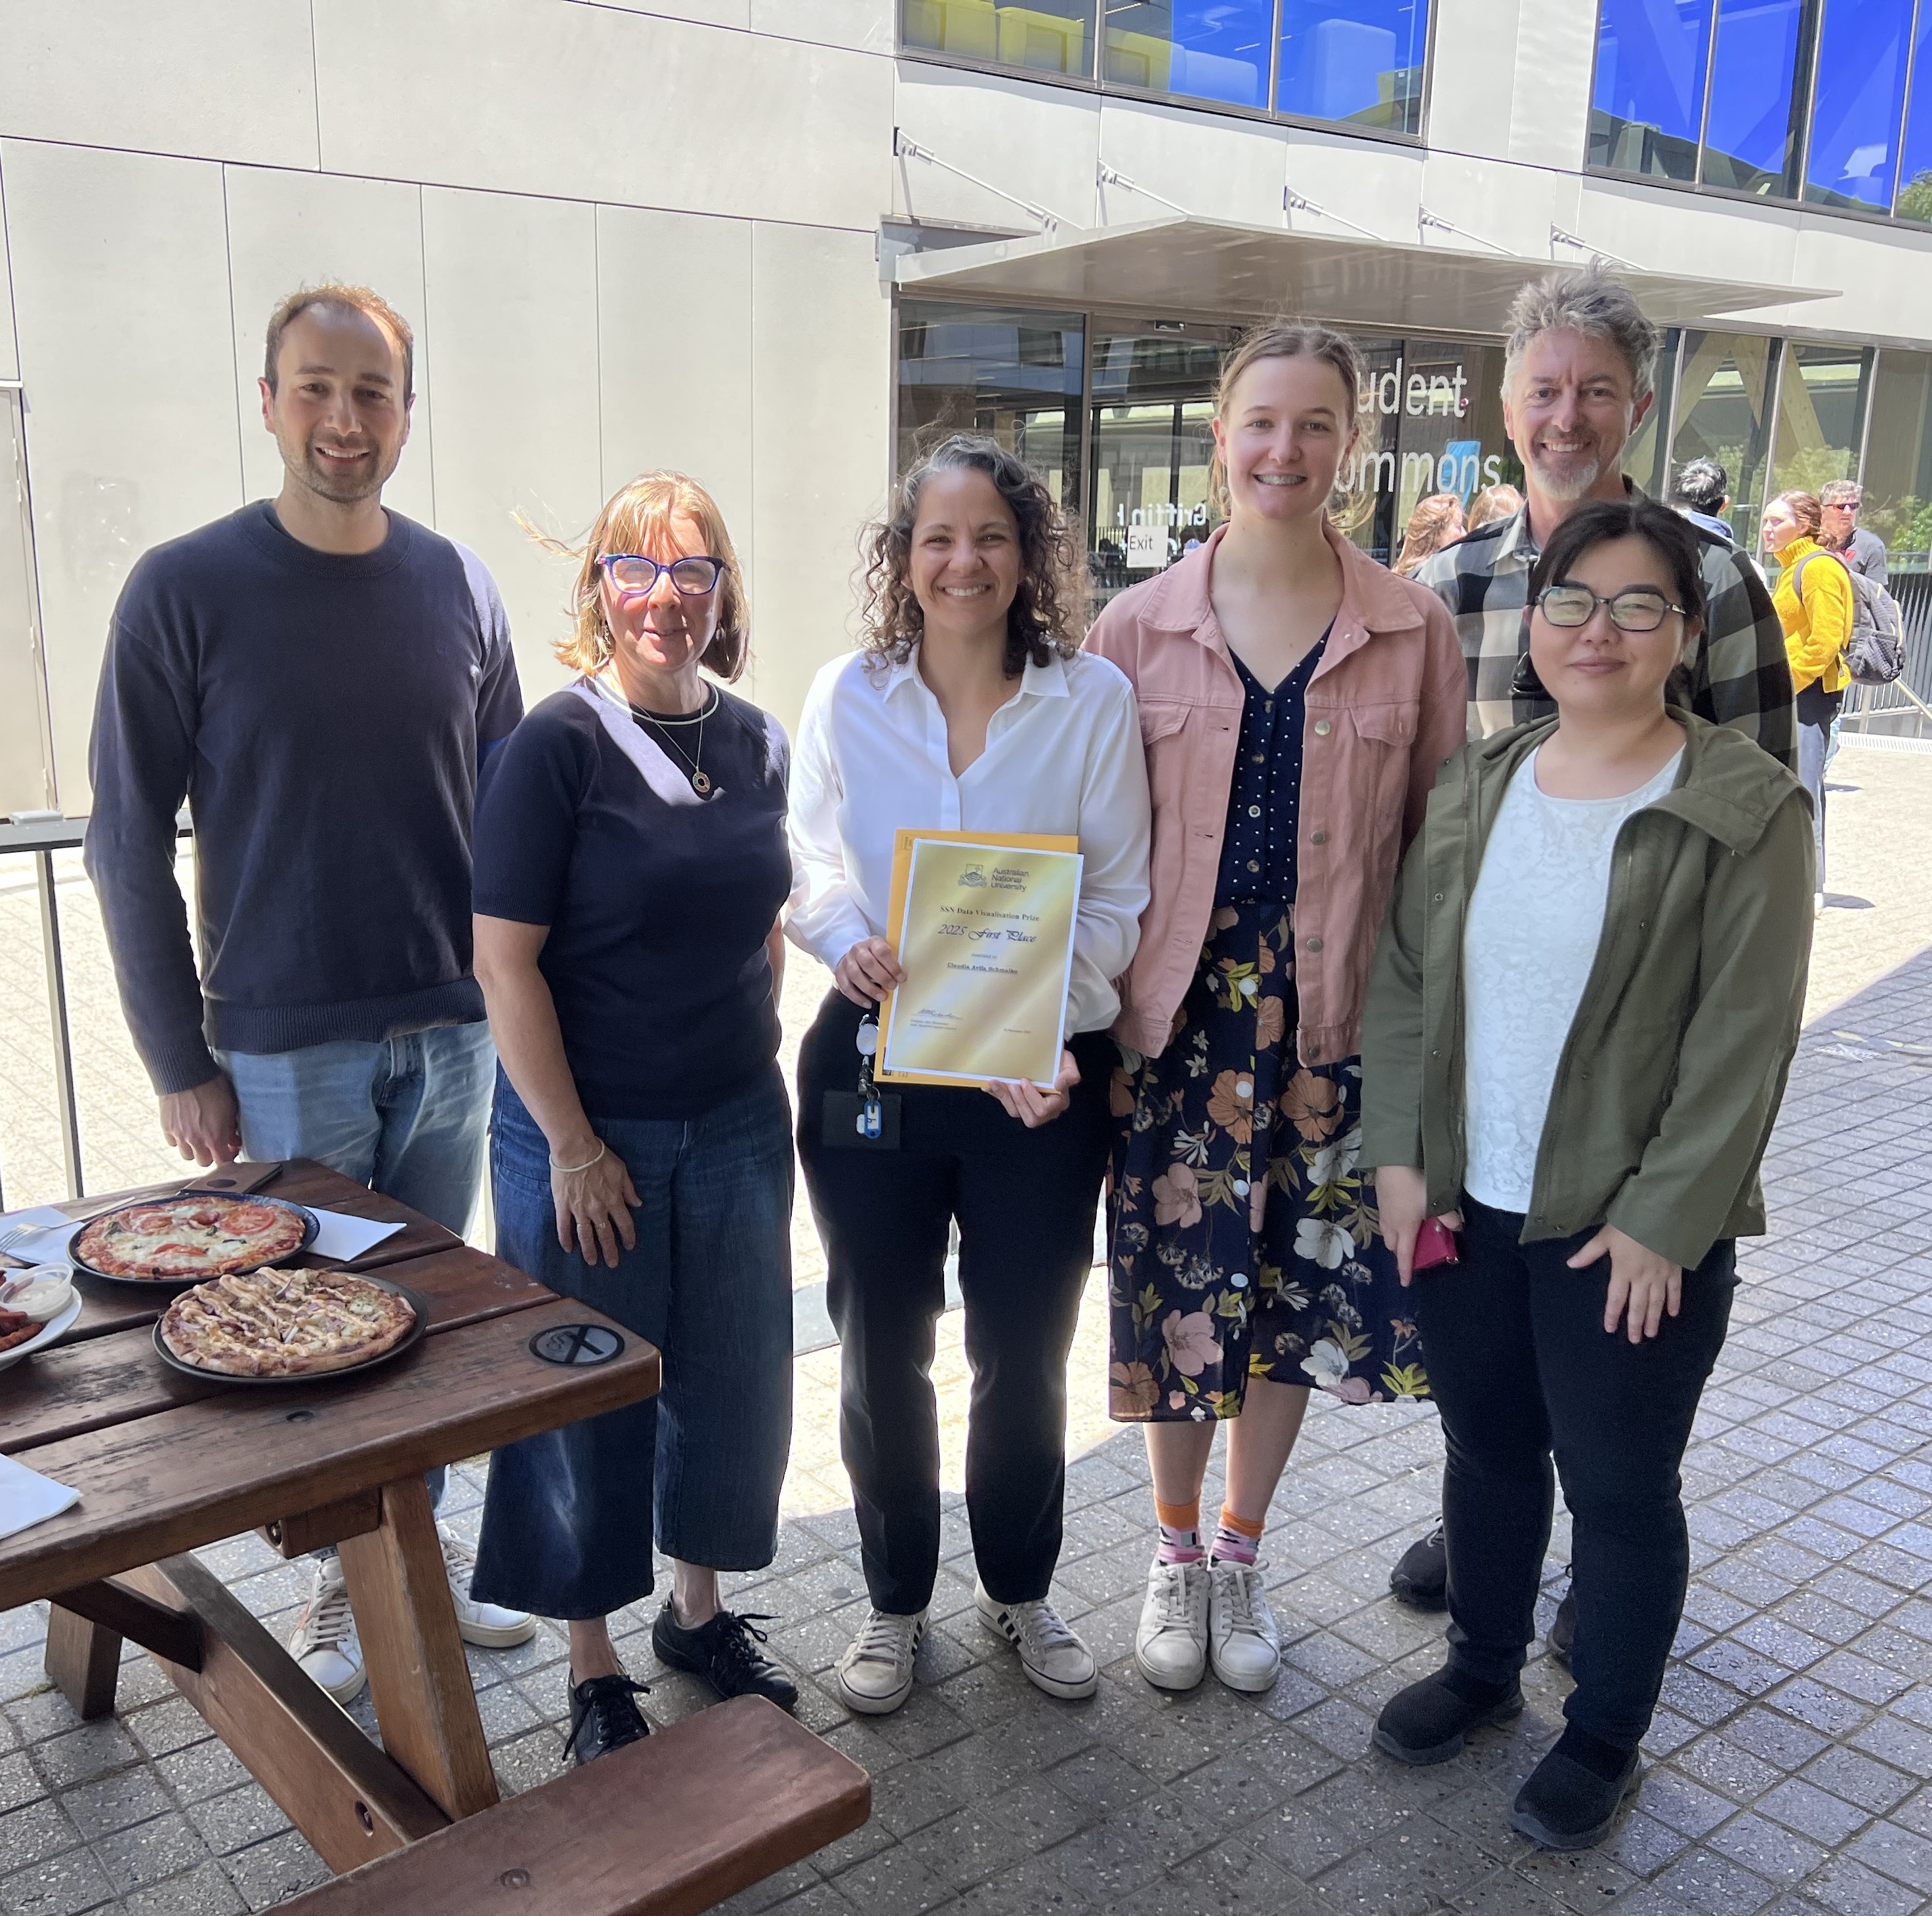
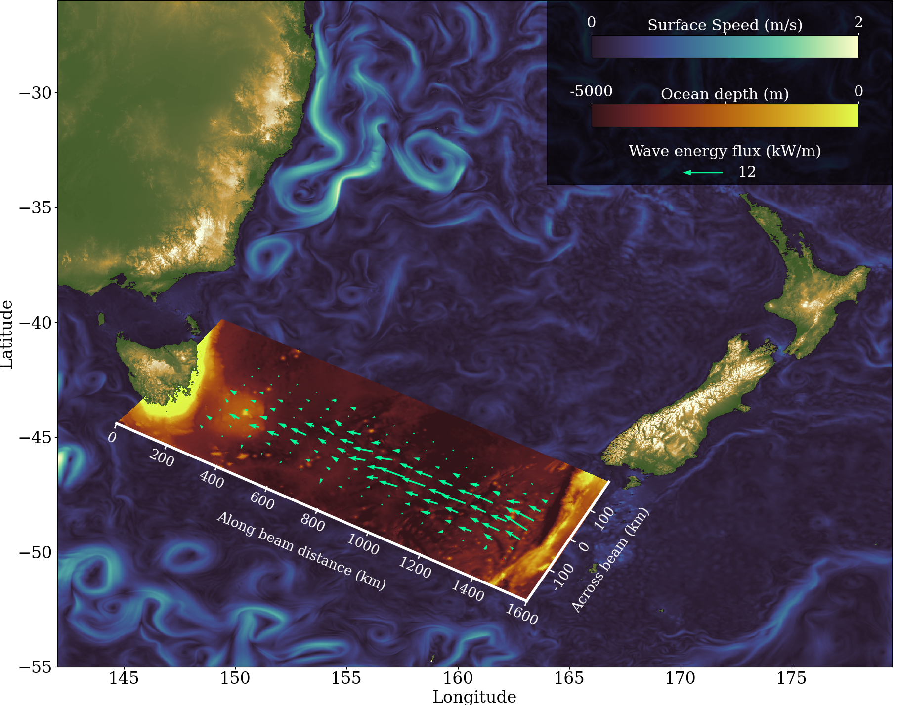
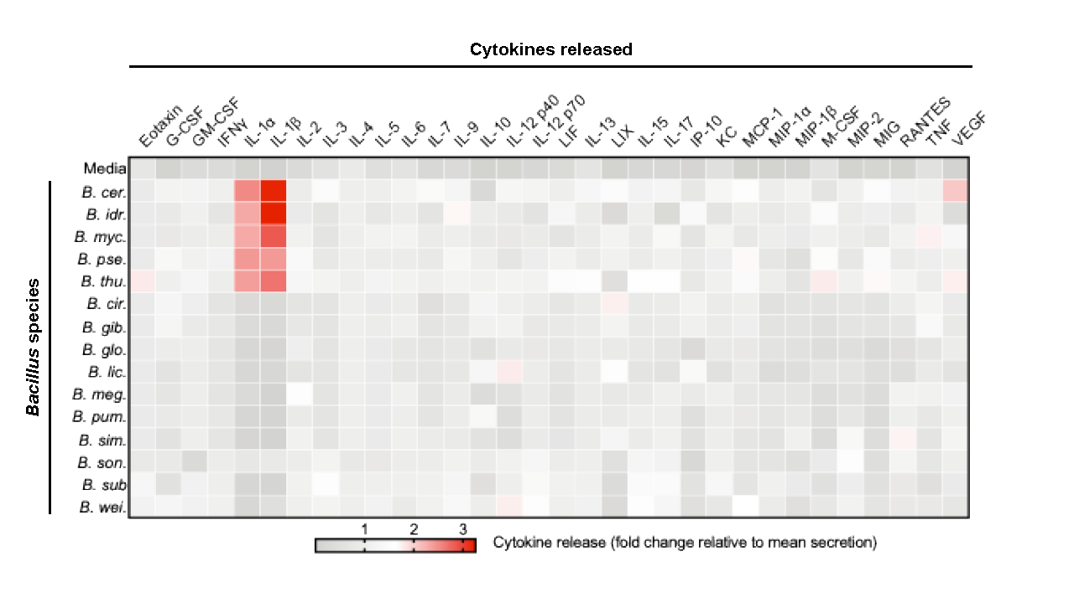
Data visualisation
https://anuopensci.github.io/SSN-datavis/

Slide 8
Could have gone better

Slide 9
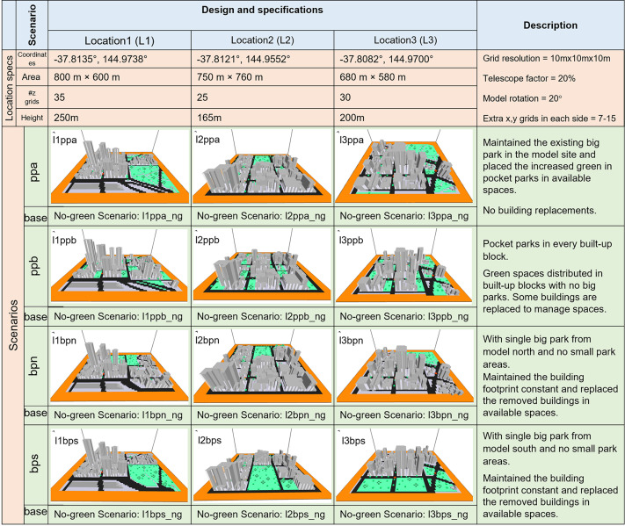
Pocket parks
Urban parks are popular as an efficient mitigator of extreme heat in cities
Uncertainties remain regarding whether and how the spatial configuration affects the effectiveness in practice
Compare the amelioration potential of urban parks with the same green ratio in different spatial configurations
Linear mixed models assessed the effect of scenario on outcomes such as modelled temperature reduction
https://www.sciencedirect.com/science/article/pii/S2212095523003504

Slide 10
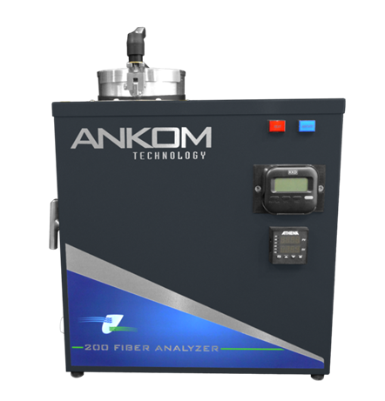
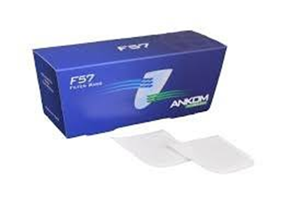
Filter bags
Dried, ground plant samples weighed and put into small filter bags, then washed in either neutral or acid solvent. The samples were then re-weighed and then calculated how much fibre (ADF) that sample contained. Two different filter bags were used; F57 and F58.
The first objective is to align the ADF values from the F57 filter bags with the more accurate and less variable F58 measurements to resolve the disparity resulting from particle loss/gain during solvent wash.
Second is to apply this same equation to the lignin(ADL) results, to account for particle loss/gain in next step of analysis

Slide 11
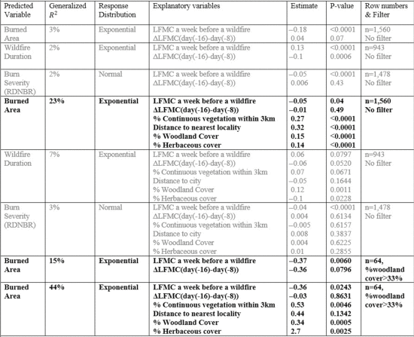
Bushfires
Outcomes: spread of fire (log10(m²/day) or log10(m²)?), fire radiative power
Gaussian? Gamma?
Explanatory variables: live fuel moisture content, temperature, relative humidity, wind speed, slope, …
Random effect: fire season
Nothing looked quite right … but later …
DOI: 10.1109/JSTARS.2024.3445138
Notes:
Gianluca Scortechini, Nov 2021 – May 2022

Slide 12
In the statistical jungle

Slide 13
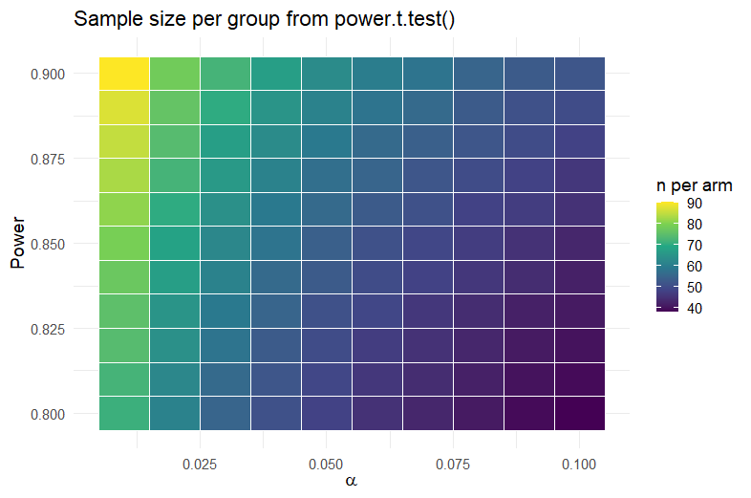
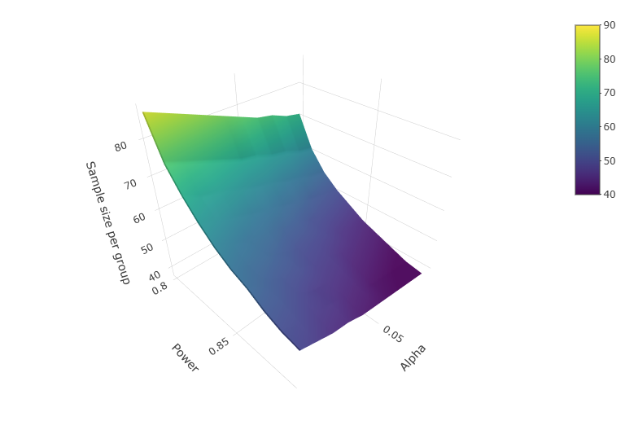
Compromise power calculations
In G*Power manual: Compromise analyses find implied power based on the beta/alpha ratio, or q, and inputted values for effect size and sample size
In other words: a technique to reverse justify your sample size, MCID and SD with the power and alpha that “make it work”
https://osf.io/preprints/psyarxiv/9d3yf_v1
Example using delta = 0.7, sd = 1.2, alpha = 0.1(0.01)10 and beta = 0.8(0.01)0.9

Slide 14
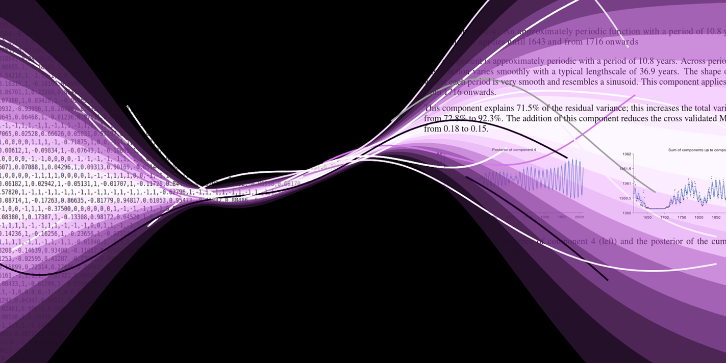
Automated statistics
automaticstatistician.com was a thing up to about 2019
In between came the ever-helpful software (less in the biometric space)
Then along came genAI

Slide 15
Can’t give a talk like this without generative AI popping up somewhere!
Would you describe logistic regression as one of the class of linear models, or is it something different?

Slide 16
Good question — this is one of those “it depends how precise you want to be” situations 🙂
Logistic regression is not a linear regression model. In ordinary linear regression we assume 𝑌=𝛽₀+𝛽₁𝑋₁+ ⋯ +𝛽_{𝑝}𝑋_{𝑝}+𝜀​ …
Logistic regression, by contrast, models a binary outcome (0/1) …
Logistic regression is a generalized linear model (GLM). GLMs extend linear models by allowing different outcome distributions (e.g., binomial, Poisson, Gaussian) …
✅ So the cleanest phrasing is: Logistic regression is not a linear regression, but it is part of the wider class of generalized linear models.
But I’ve been conversing with ChatGPT for some months now …

Slide 17
Conclusion

Slide 18

Conclusion
We are the guides to the jungle
We keep abreast of new developments
Guides work together too

Slide 19



Thankyou for your attention!
Email: alice.richardson@anu.edu.au
Thanks to my fellow guides:
Anton Westveld
Emi Tanaka
Francis Hui

Slide 20


Qualtrics will provide a recommended analysis based on assumptions it makes about the scale of your variables (categories, numbers)
It will provide other analyses as well …
Q36: In your opinion, does the … (strongly agree = 1 to strongly disagree = 5)
Q50: to what extent does … (scale of 1 = low to 10 = high)
Notes:
Melissa’s data, Q50_4 and Q36_10

Slide 21
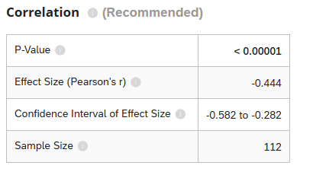
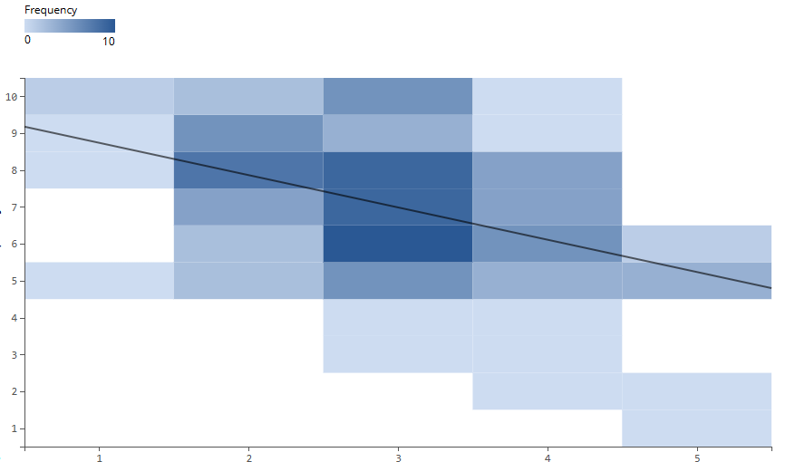
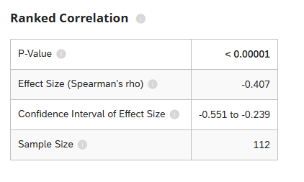
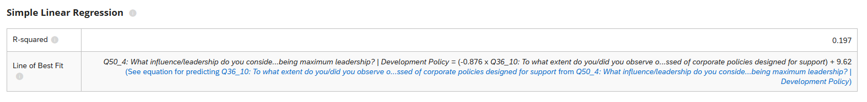
Treating the scale of 1 to 10 as the outcome, and the scale from 1 to 5 (SA … SD) as the numeric predictor
Notes:
Melissa’s data, Q50_4 and Q36_10

Slide 22
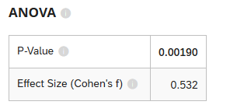
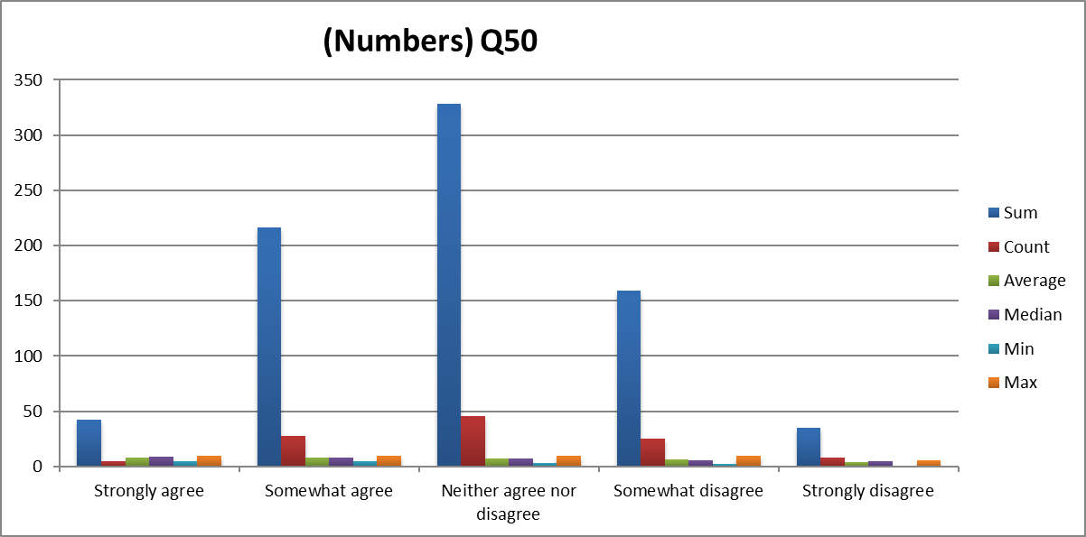
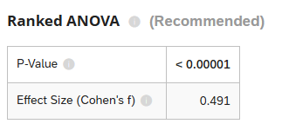
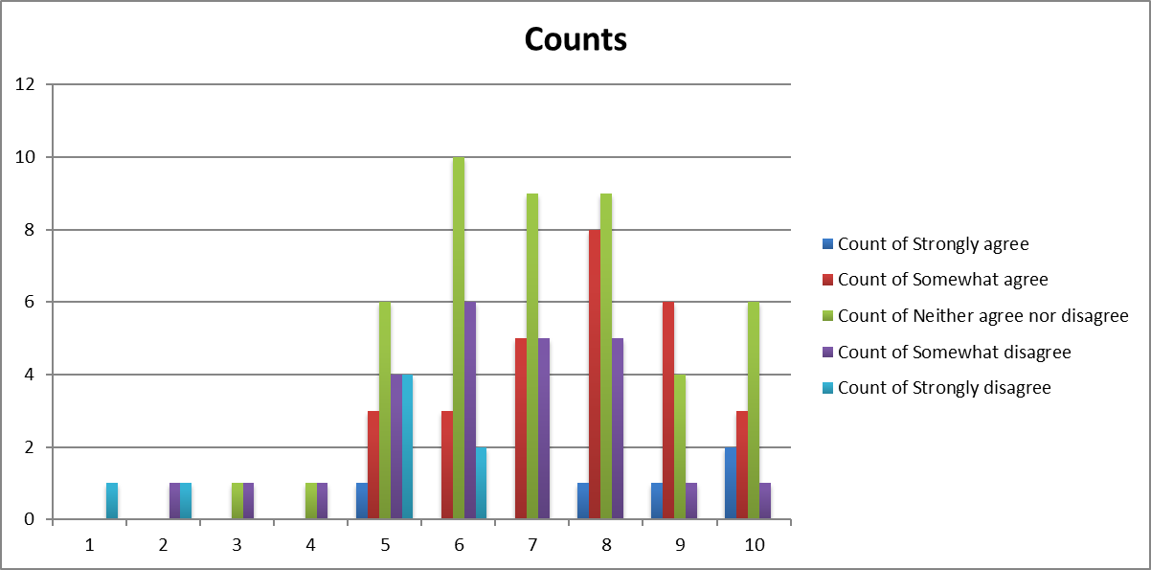
Treating the scale from 1 to 5 as categorical and the scale from 1 to 10 as numeric
“When assumptions are violated, the unranked ANOVA may no longer be valid. In that case, Stats iQ recommends the ranked ANOVA (also called “ANOVA on ranks”); Stats iQ rank-transforms the data (replaces values with their rank ordering) and then runs the same ANOVA on that transformed data.”
Notes:
Melissa’s data, Q50_4 and Q36_10. You can have the counts as percentages too
https://www.qualtrics.com/support/stats-iq/analyses/statistical-test-assumptions-technical-details/#ANOVA

Slide 23
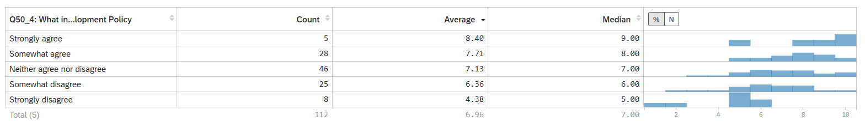
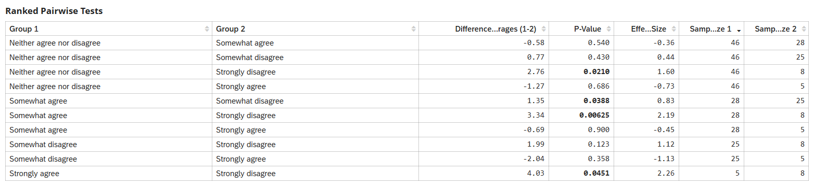
Notes:
Melissa’s data, Q50_4 and Q36_10

